Slide 1
Claude the SAS Programmer
Agentic AI creates SAS 9 code before your eyes

Slide 2


Github Link for Powerpoint + Code
Joe Matise
Supervisor, Data Engineering, NORC

Slide 3


Agenda
1
Introduction – What is Agentic AI?
2
Using Agentic AI with SAS: Tools Required
3
Let’s Code!
4
Prompt Engineering: Programming the Programmer
5
Conclusion

Slide 4
About this presentation
This presentation is targeted to SAS 9.4, not SAS Viya. See the sessions about SAS Viya MCP for more information there!
Most of what I present here applies to any Agentic AI solution, but Claude Code is the solution I tested this with and use for the examples.
As with any AI solution – use this with caution and skepticism of the results. Read the documentation for your chosen solution how to protect yourself from the Agentic AI doing dangerous things.

Slide 5
What is Agentic AI?

Slide 6
What is Agentic AI?
Agentic AI can independently break down complex tasks, use tools, and iterate on solutions with minimal human intervention. (Claude Sonnet 4.5)
The ability to run code independently and verify the results is a key differentiator for Agentic AI
In order for Agentic AI to function at its full potential, there must be a connection between the AI and SAS.

Slide 7

Examples of Agentic AI
Claude Code
Codex

Slide 8
Why use Agentic AI?
Agentic AI does not replace the programmer – it changes the relationship with the code.
Agentic AI is a tool that can increase productivity when used properly
Guiding the AI to produce code that gives good results is not an easy task!
When used with good tests and well-developed prompts, Agentic AI can reduce the time to deliver results significantly.
Also strongly consider this for data exploration – similar to how Visual Analytics is often used.

Slide 9
Tools for using SAS with Agentic AI

Slide 10
Tools for using Agentic AI
Requirements
Interface
How do you interact with the Agentic AI?
The Agentic AI solution
This depends on your interface
Follow the interface-specific configuration steps
Method of connecting to SAS
How does the Agentic AI submit SAS code?
How does the Agentic AI read the results of the SAS code?

Slide 11
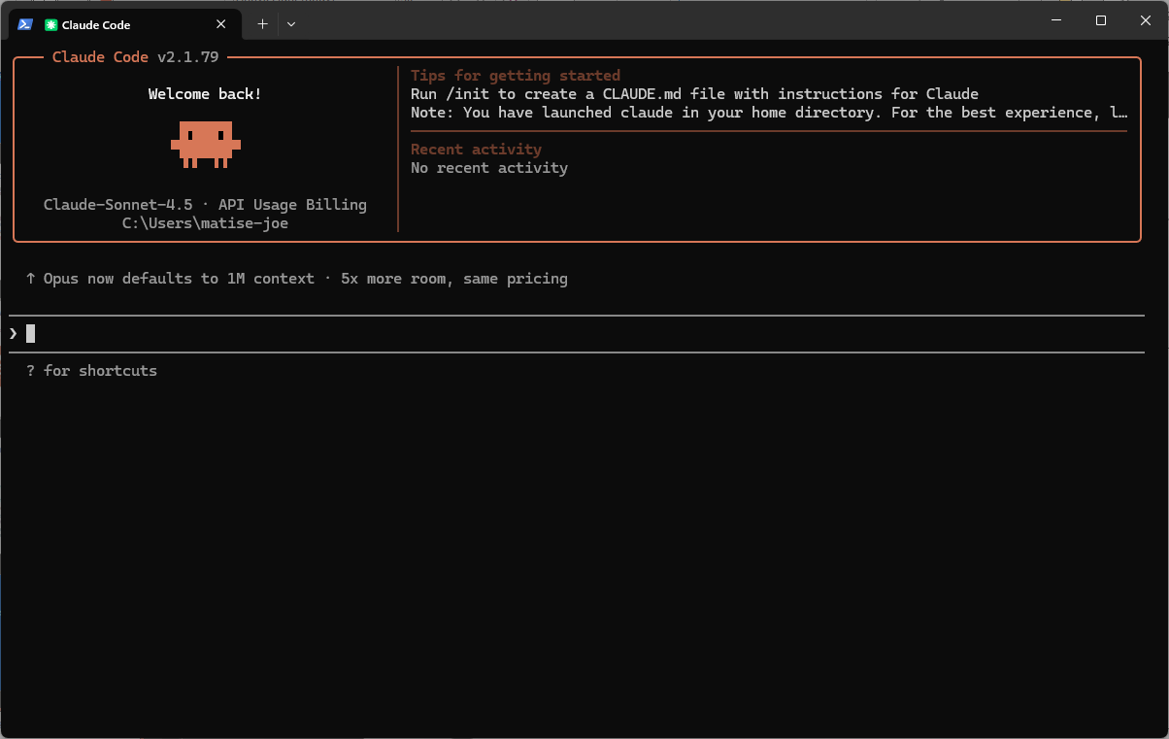
Tools for using Agentic AI
Interface Options
Options for Agentic AI
Standalone (command line/terminal)
Component to IDE like VS Code
Chat-like interface
Recommendation: VS Code Extension
https://code.visualstudio.com/
https://code.claude.com/docs/en/vs-code
Notes:
Next slide – show it writing code

Slide 12
Tools for using Agentic AI
Backend Options for submitting SAS Code
Options for submitting SAS code
Direct SAS connection via batch submission at the command line
SASPy – via Python
SAS Viya has API options available as well
Recommendation: SASPy; most flexible and best parsing of results.

Slide 13
Tools for using Agentic AI
SASPy
SASPy is an open source Python package that allows Python coders to access SAS data and analytics capabilities. Add SASPy to your Python environment, configure it to connect to your SAS environment, and begin using Python to access SAS.
https://support.sas.com/en/software/saspy.html
https://github.com/sassoftware/saspy/releases

Slide 14
Tools for using Agentic AI
Configuring SASPy for SAS Server connections
Option 1: SSH - https://sassoftware.github.io/saspy/configuration.html#ssh
This is the common terminal connection, which allows SSH-based connectivity and works with both Linux and Windows servers. Works best with simple configurations.
Option 2: IOM - https://sassoftware.github.io/saspy/configuration.html#iom
This is useful for more complex configurations, including Grid.
Requires Java
Option 3: COM – https://sassoftware.github.io/saspy/configuration.html#com
This only works for Windows clients, but avoids using Java!
For all options, determine how you will connect – type in password interactively, use .authinfo/_authinfo, or other options.
Notes:
Table of options/etc on a next slide

Slide 15
Tools for using Agentic AI
SASPy Connection Wrapper
https://github.com/matise-joe-norc/connect-saspy/
Useful Python code for helping the Agentic AI easily connect to SASPy
Allows submitting code with a single Python method call (after connection is established)
Contains many comments that will improve the ability of Agentic AI to utilize the class

Slide 16
connect_saspy.py
The wrapper that makes it work
Methods:
_start_connection(): internal method to initiate the SASPy connection
_test_connection(): internal method to validate the SASPy connection
submit(code): Submits SAS code (as text) to SASPy. Starts a connection if none exists.
close_connection(): Closes the SASPy connection
Automatically initiates a connection to SASPy – no action needed by the AI!

Slide 17
SASPy/connect_saspy Best Practices
Use an SSH Key or Authinfo file so the connection is automatic with no user intervention needed
Keep the connect_saspy.py and example_usage.py in the folder you are working with, or in a related folder in the context window
Make sure saspy is in your requirements.txt file
Test using connect_saspy yourself before using it with the AI

Slide 18
Let’s Code!
Live demos with AI never go wrong…
so we will use a recording instead ☺

Slide 19
The Prompt
Please use the file sas_prompt.txt in the currently open folder as instructions, before doing anything else from this request.
Please use the folder ~\SASInnovate for interfacing with the SAS server in this project. Use the currently open folder for the Jupyter Notebook. Add the newly created folder to the current VS Code workspace as an additional folder.
Please run an analysis on the SASHELP.BASEBALL dataset. The object of this analysis is to show which players had the best batting statistics.
The report should be written to Microsoft Excel (.xlsx) format. Use professional styling to improve the look and feel of this report so that I can present it to the CEO of my company.
Please run this and validate that it produces valid output.

Slide 20
Youtube link goes here

Slide 21
Prompt Engineering Tips
Programming the (AI) Programmer…

Slide 22
Prompt Engineering
1
2
3
Settings
These affect what the Agentic AI is able to do.
Pre-Prompt
A prompt with basic information that guides the Agentic AI towards better results, that is useful for many projects.
Prompt
User-specified prompt that specifically asks the Agentic AI to do what is needed for this project.

Slide 23
Prompt Engineering
Example SAS Preprompt: Key Elements
Tell the Agent where to find key programs or spaces
Example programs often improve results
Give it any environment details that are necessary for your space
Server-based SAS: can SAS read the current folder?
Tell it how to write the Python program that runs your SAS code
Direct what kind of code you want to see (Macros, SQL, etc.)
You will get a lot of SQL if you don’t ask it not to!
Learn over time how to improve this – any time something goes wrong, add something to this to improve it
After completing a session, consider asking for improvements to the prompt!

Slide 24
Prompt Engineering
The prompt from the example
Please use the file sas_prompt.txt in the currently open folder as instructions, before doing anything else from this request.
Please use the folder ~\SASInnovate for interfacing with the SAS server in this project. Use the currently open folder for the Jupyter Notebook. Add the newly created folder to the current VS Code workspace as an additional folder.
Please run an analysis on the SASHELP.BASEBALL dataset. The object of this analysis is to show which players had the best batting statistics.
The report should be written to Microsoft Excel (.xlsx) format. Use professional styling to improve the look and feel of this report so that I can present it to the CEO of my company.
Please run this and validate that it produces valid output.

Slide 25
Prompt Engineering
Key considerations for your prompt
Organize your prompt
If you are building a report, start by talking about the data source, then modifications, then move on to the report specifications.
Be specific!
Tell the agent where to write files
Give it clear instructions for formatting/etc
If possible, point the agent to a properly formatted document
Save your prompt outside of the Agentic environment!
Easier to recover if something crashes
Learn over time from saved copies!

Slide 26
Questions?

Slide 27
Thank you!

